Slide 1
BINOMIAL PRICING MODEL

Slide 2
A SIMPLE BINOMIAL MODEL
A stock price is currently $20
In 3 months it will be either $22 or $18
Stock Price = $22
Stock price = $20
Stock Price = $18

Slide 3
A CALL OPTION
A 3-month call option on the stock has a strike price of 21.
Stock Price = $22
Option Price = $1
Stock price = $20
Option Price=?
Stock Price = $18
Option Price = $0

Slide 4
SETTING UP A RISKLESS PORTFOLIO
Consider the Portfolio: long Δ shares short 1 call option
Portfolio is riskless when 22Δ – 1 = 18Δ or
  Δ = 0.25
22Δ – 1
18Δ

Slide 5
VALUING THE PORTFOLIO
(RISK-FREE RATE IS 12%)
The riskless portfolio is:
long 0.25 shares short 1 call option
The value of the portfolio in 3 months is
22 × 0.25 – 1 = 4.50
The value of the portfolio today is
4.5e ^{– 0.12×0.25} = 4.3670

Slide 6
VALUING THE OPTION
The portfolio that is
long 0.25 shares short 1 option
is worth 4.367
The value of the shares is 5.000 (= 0.25 × 20 )
The value of the option is therefore 0.633 (= 5.000 – 4.367 )

Slide 7
GENERALIZATION
A derivative lasts for time T and is dependent on a stock
S₀u
ƒ_{u}
S₀
ƒ
S₀d
ƒ_{d}

Slide 8
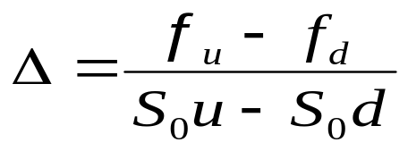
GENERALIZATION
(CONTINUED)
Consider the portfolio that is long Δ shares and short 1 derivative
The portfolio is riskless when S₀uΔ – ƒ_{u} = S₀dΔ – ƒ_{d} or
S₀uΔ – ƒ_{u}
S₀dΔ – ƒ_{d}

Slide 9
GENERALIZATION
(CONTINUED)
Value of the portfolio at time T is S₀uΔ – ƒ_{u}
Value of the portfolio today is
(S₀uΔ – ƒ_{u})e^{–rT}
Another expression for the portfolio value today is S₀Δ – f
Hence ƒ = S₀Δ – (S₀uΔ – ƒ_{u} )e^{–rT}

Slide 10
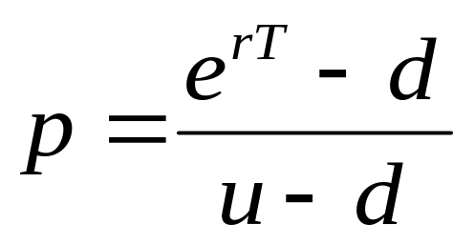
GENERALIZATION
(CONTINUED)
Substituting for Δ we obtain
ƒ = [ pƒ_{u} + (1 – p)ƒ_{d} ]e^{–rT}
where

Slide 11
p as a Probability
It is natural to interpret p and 1-p as probabilities of up and down movements
The value of a derivative is then its expected payoff in a risk-neutral world discounted at the risk-free rate
S₀u
ƒ_{u}
p
S₀
ƒ
S₀d
ƒ_{d}
(1 – p )

Slide 12
RISK-NEUTRAL VALUATION
When the probability of an up and down movements are p and 1-p the expected stock price at time T is S₀e^{rT}
This shows that the stock price earns the risk-free rate
Binomial trees illustrate the general result that to value a derivative we can assume that the expected return on the underlying asset is the risk-free rate and discount at the risk-free rate
This is known as using risk-neutral valuation

Slide 13
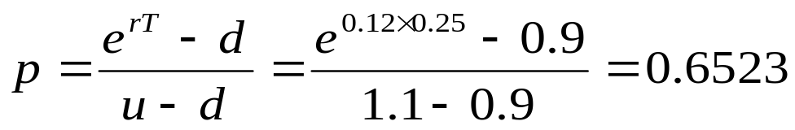
ORIGINAL EXAMPLE REVISITED
S₀u = 22
ƒ_{u} = 1
Since p is the probability that gives a return on the stock equal to the risk-free rate. We can find it from
20e^{0.12 ×0.25} = 22p + 18(1 – p )
which gives p = 0.6523
Alternatively, we can use the formula
p
S₀
ƒ
S₀d = 18
ƒ_{d} = 0
(1 – p )

Slide 14
VALUING THE OPTION USING RISK-NEUTRAL VALUATION
The value of the option is
e^{–0.12×0.25} (0.6523×1 + 0.3477×0)
= 0.633
S₀u = 22
ƒ_{u} = 1
0.6523
S₀
ƒ
S₀d = 18
ƒ_{d} = 0
0.3477

Slide 15
IRRELEVANCE OF STOCK’S EXPECTED RETURN
When we are valuing an option in terms of the price of the underlying asset, the probability of up and down movements in the real world are irrelevant
This is an example of a more general result stating that the expected return on the underlying asset in the real world is irrelevant

Slide 16
A TWO-STEP EXAMPLE
Each time step is 3 months
K=21, r=12%
24.2
22
20
19.8
18
16.2

Slide 17
VALUING A CALL OPTION
Value at node B is
e^{–0.12×0.25}(0.6523×3.2 + 0.3477×0) = 2.0257
Value at node A is
e^{–0.12×0.25}(0.6523×2.0257 + 0.3477×0) = 1.2823
24.2
3.2
D
22
B
20
1.2823
2.0257
19.8
0.0
A
E
18
C
0.0
16.2
0.0
F

Slide 18
A PUT OPTION EXAMPLE
K = 52, time step =1yr
r = 5% ; S=50 ; 2 yr EP; % change =20%
72
0
D
60
B
50
4.1923
1.4147
48
4
A
E
40
C
9.4636
32
20
F

Slide 19
A PUT OPTION EXAMPLE -CONTINUED
P= (e^{0.05*1})-0.8 / 1.2-0.8
=0.6282
Put= e ^{(-.05*1) *} (0.6282*0)+(0.3718*4)
^{=1.4147}

Slide 20
WHAT HAPPENS WHEN PUT OPTION IS AMERICAN
72
0
D
60
B
50
5.0894
1.4147
48
4
A
E
40
C
12.0
32
20
F

Slide 21
WHAT HAPPENS WHEN PUT OPTION IS AMERICAN
Final node is the same as EP
At earlier nodes option value will be greater of the following 2 values
  1. Value derived by the equation
  2. Pay off from early exercise
  At node B – early exercise not profitable- Option Value is 1.4147
  Equation Value is1.4147
  Pay off is (52-60) = -8
  At noted C – early exercise has positive pay off and is the value of option
  Equation Value is 9.46
  Pay off is (52-40) = 12

Slide 22
DELTA
Delta (Δ) is the ratio of the change in the price of a stock option to the change in the price of the underlying stock
The value of Δ varies from node to node

Slide 23
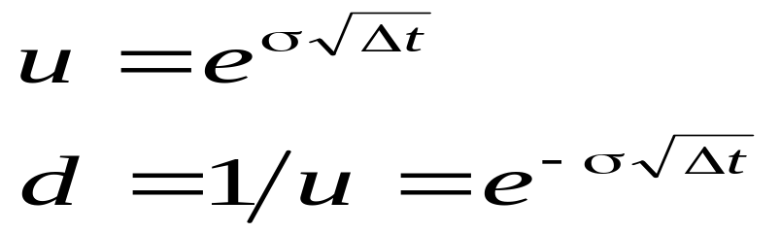
CHOOSING U AND D
One way of matching the volatility is to set
where σ is the volatility and Δt is the length of the time step. This is the approach used by Cox, Ross, and Rubinstein

